Slide 1
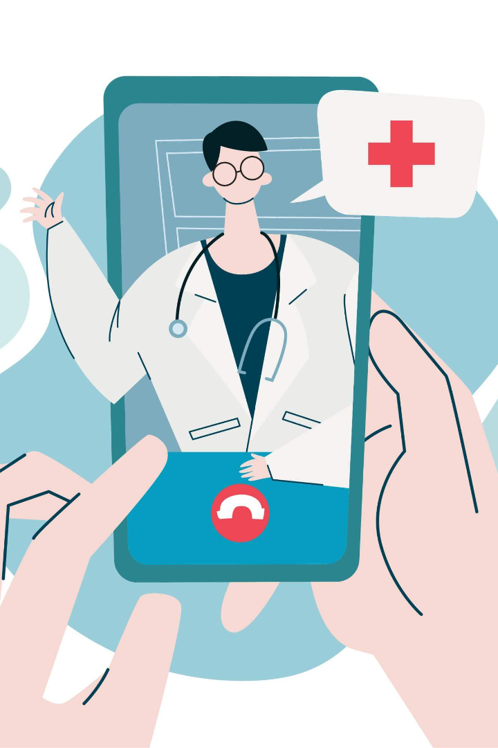
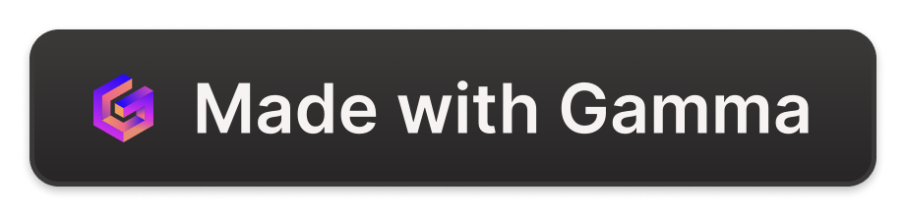
MYDOC
A website that can help you to self diagnose and help to maintain your medical records.
BY- 1. PRATHAM AGARWAL
2. MILIND KASHYAP

Slide 2
PROBLEM STATEMENT.
1- People finds it difficult and time consuming to find and consult a doctor for every small problem.
2-they just assume what they are suffering from and buy medication accordingly but this is a serious problem.
3- It is hard to maintain or remember details of all you medical history and treatments ,which is sometimes important for any future treatments.

Slide 3
Solution
You can feed your symptoms and our system will tell you the disease you may be suffering from and
also tells you about the doctors in your area where you can go and consult.
and its also helps in storing the data related to your previous medical treatments very easily.

Slide 4
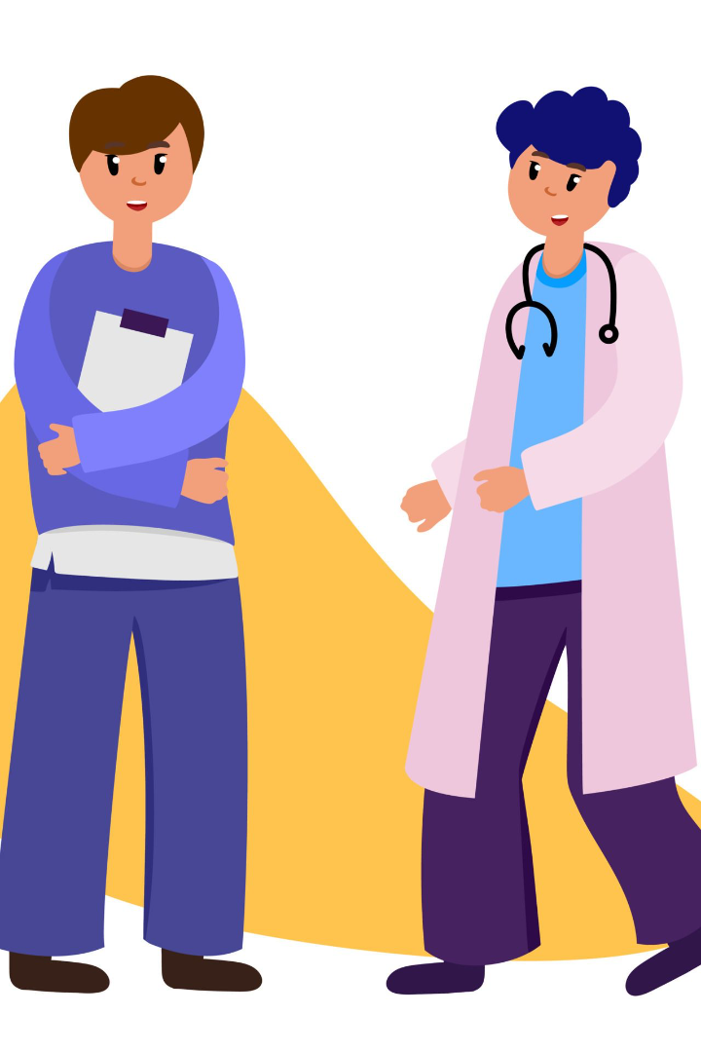
With two interfaces:
Patient Interface
Doctor Interface

Slide 5
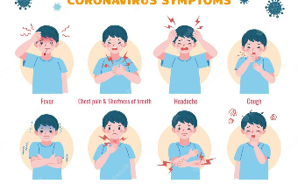
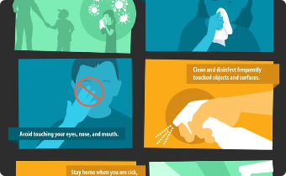

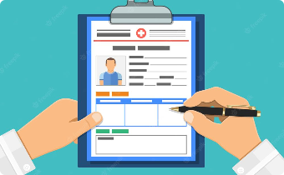
features of patient interface.
1-Check for diseases by analyzing your symptoms.
2- See the ways to prevent and treat the particular disease.
3-Find nearby doctors.
4-Store medical history for future references.

Slide 6

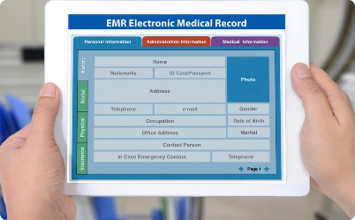
features of Doctor interface.
1-Store patient records of their hospital/clinic.
2- Fetch the data of a particular patient by their name or disease.

Slide 7
How the diagnosis works
1
Step 1
Enter your symptoms in the self-diagnosis tool and submit the form.
2
Step 2
Our algorithm matches your symptoms with our comprehensive disease database.
3
Step 3
The website displays a list of possible diseases and provides tips on preventing and treating them.
4
Step 4
The website displays a list of best doctors/labs nearby you for the diseases that you diagnosed for.

Slide 8
language/software used.
1- Collab(for python)
2- Excel / Mysql (dataset)
3- Spyder/ Anaconda.navigator (front-end)

Slide 9
Benefits of Self-Diagnosis
Accessibility
time saving
Cost-effective
24/7 availability means you can check symptoms anytime and anywhere.
No need to make appointments or visit doctors, thus providing privacy and peace of mind.
It's a free to check for diseases and stay informed about your health.

Slide 10
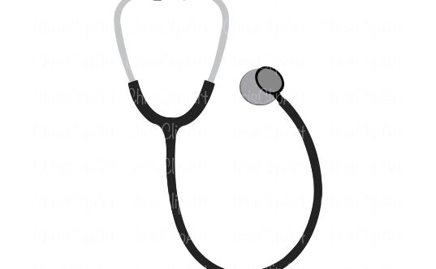

Limitations of the Website
Professional Diagnosis
Accuracy
The website is not intended to replace a doctor's consultation or diagnosis. If symptoms persist, please consult a physician for further evaluation.
The website's ability to diagnose a condition accurately depends solely on the information you provide.

Slide 11

Conclusion
While self-diagnosing can be helpful, it is important to consult a doctor for professional advice. Our website is a tool that provides information about your symptoms. Remember, early detection can save lives. Take charge of your health today!

